Slide 1
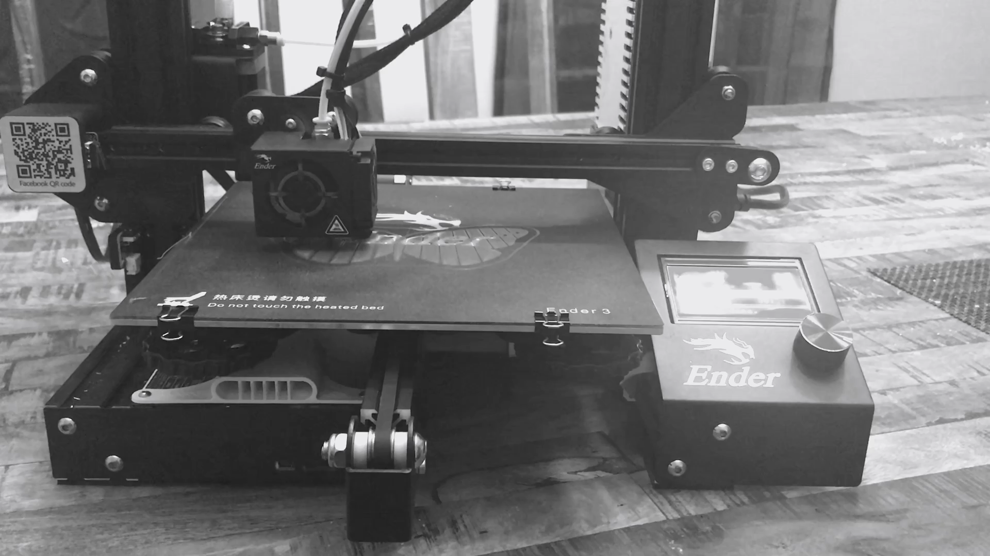

STL 3D Printing
Creating physical objects from digital models
Home Products Contact About Us
Notes:
Change font – look at typography

Slide 2
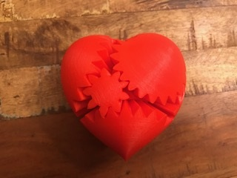
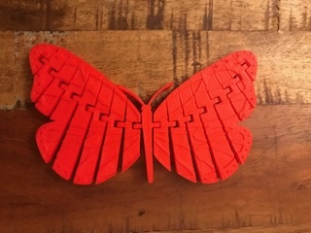
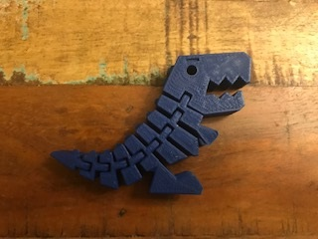
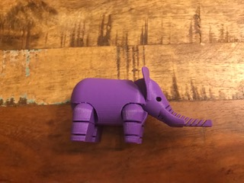
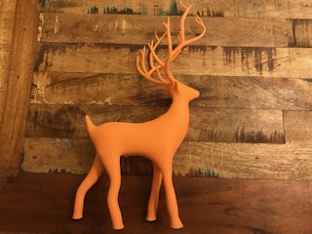
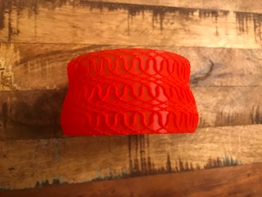
Home Products Contact About Us
Name
Name
Name
Name
Name
Name
Notes:
Change shade of gray, white background

Slide 3
Home Products Contact About Us
Bacon ipsum dolor amet sirloin tail frankfurter
tongue meatloaf. Beef flank ground round
capicola biltong, venison salami t-bone
fatback hamburger turducken cupim.
Measurements
Quantity
Color
Add to cart
Notes:
Change shade of gray, white background

